Slide 1
Pre-Announcements (BEAM)
61B TAs Kevin and Alex and Nicole are here to say in their freetime that they participate in a group called Berkeley Engineering and Mentoring.
Mentoring for elementary/middle school kids.
Infosession at 8:00 PM in 145 Dwinelle.
Also, PIZZA.

Slide 2
Announcements
Project 1A is out.
Very strongly encouraged to work on this project in IntelliJ.
Having the ability to visually debug your code is incredibly useful.
Having your IDE yell at you about compilation errors while you are writing code is really nice to avoid issues with, for example, generics.
Autograder is up, but we still want you to write your own tests.
Tests not graded.
On part 1B there will be graded tests, so might be worthwhile to write tests just to save yourself some work next week.
LOST section starts tomorrow.
Tuesdays 5-6 Dwinelle 187 section. Will cover previous week’s material.

Slide 3

CS61B, 2018
Lecture 6: Arrays and Lists
A Last Look at Linked Lists
Naive Array Lists
Resizing Arrays
Generic ALists
Obscurantism in Java

Slide 4
A Last Look at Linked Lists

Slide 5
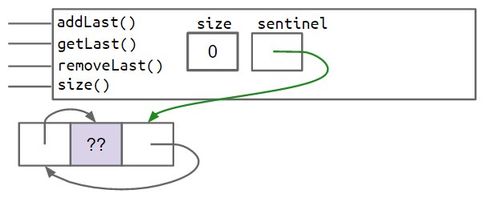
Doubly Linked Lists
Behold. The state of the art as we arrived at in last week’s lecture. Through various improvements, we made all of the following operations fast:
addFirst, addLast
getFirst, getLast
removeFirst, removeLast
You will build this in project 1A.
addLast()
size
sentinel
getLast()
3
removeLast()
get(int i)
??
5
17
38
prev
value
next

Slide 6
Arbitrary Retrieval
Suppose we added get(int i), which returns the ith item from the list.
Why would get be slow for long lists compared to getLast()? For what inputs?
addLast()
size
sentinel
getLast()
3
removeLast()
get(int i)
??
5
17
38
prev
value
next

Slide 7
Arbitrary Retrieval
Suppose we added get(int i), which returns the ith item from the list.
Why would get be slow for long lists compared to getLast()? For what inputs?
Have to scan to desired position. Slow for any i not near the sentinel node.
How do we fix this?
addLast()
size
sentinel
getLast()
3
removeLast()
get(int i)
??
5
17
38
prev
value
next

Slide 8
Arbitrary Retrieval
Suppose we added get(int i), which returns the ith item from the list.
Why would get be slow for long lists compared to getLast()? For what inputs?
Have to scan to desired position. Slow for any i not near the sentinel node.
Will discuss (much later) sophisticated changes that can speed up lists.
For now: We’ll take a different tack: Using an array instead (no links!).
addLast()
size
sentinel
getLast()
3
removeLast()
get(int i)
??
5
17
38
prev
value
next

Slide 9
Naive Array Lists

Slide 10
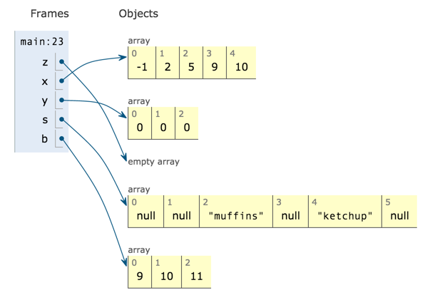
Random Access in Arrays
Retrieval from any position of an array is very fast.
Independent* of array size.
61C Preview: Ultra fast random access results from the fact that memory boxes are the same size (in bits).

Slide 11
Our Goal: AList.java
Want to figure out how to build an array version of a list:
In lecture we’ll only do back operations. Project 1A is the front operations.
addLast()
size
sentinel
getLast()
3
removeLast()
get(int i)
??
5
17
38
prev
value
next
addLast()
getLast()
???
removeLast()
Let’s try it out...
get(int i)

Slide 12
Naive AList Code
From last lecture, “things that must be true”.
public class AList {
private int[] items;
private int size;
public AList() {
items = new int[100]; size = 0;
}
public void addLast(int x) {
items[size] = x;
size += 1;
}
public int getLast() {
return items[size - 1];
}
public int get(int i) {
return items[i];
}
public int size() {
return size;
}
}
AList Invariants:
The position of the next item to be inserted is always size.
size is always the number of items in the AList.
The last item in the list is always in position size - 1.
Let’s now discuss delete operations.

Slide 13

The Abstract vs. the Concrete
When we removeLast(), which memory boxes need to change? To what?
User’s mental model: {5, 3, 1, 7, 22, -1} → {5, 3, 1, 7, 22}
Actual truth:
addLast()
getLast()
size
items
removeLast()
6
get(int i)
5
3
1
7
22
-1
0
0
...
0
0
0
0 1 2 3 4 5 6 7 97 98 99
Notes:
http://www.learning-mind.com/plato-allegory-of-the-cave/

Slide 14
Deletion: yellkey.com/dark
When we removeLast(), which memory boxes need to change? To what?
size
size and items
size and items[i] for some i
size, items, and items[i] for some i
size, items, and items[i] for many different i
addLast()
getLast()
size
items
removeLast()
6
get(int i)
5
3
1
7
22
-1
0
0
...
0
0
0
0 1 2 3 4 5 6 7 97 98 99
The position of the next item to be inserted is always size.
size is always the number of items in the AList.
The last item in the list is always in position size - 1.
AList invariants.

Slide 15
Naive AList Code
public class AList {
private int[] items;
private int size;
public AList() {
items = new int[100]; size = 0;
}
public void addLast(int x) {
items[size] = x;
size += 1;
}
public int getLast() {
return items[size - 1];
}
public int get(int i) {
return items[i];
}
public int size() {
return size;
}
}
AList Invariants:
The position of the next item to be inserted is always size.
size is always the number of items in the AList.
The last item in the list is always in position size - 1.
Setting deleted item to zero is not necessary to preserve invariants, and thus not necessary for correctness.
public int removeLast() {
int returnItem = items[size - 1];
items[size - 1] = 0;
size -= 1;
return returnItem;
}

Slide 16
The Mighty AList
Key Idea: Use some subset of the entries of an array.
addLast()
getLast()
size
items
removeLast()
6
get(int i)
5
3
1
7
22
-1
3
2
...
7
12
4
0 1 2 3 4 5 6 7 97 98 99

Slide 17
The Mighty (?) AList
Key Idea: Use some subset of the entries of an array.
addLast()
getLast()
size
items
removeLast()
100
get(int i)
5
3
1
7
22
-1
5
7
...
-1
5
7
0 1 2 3 4 5 6 7 97 98 99
What happens if we insert into the AList above? What should we do about it?

Slide 18
Resizing Arrays

Slide 19
Array Resizing
size==items.length
When the array gets too full, e.g. addLast(11), just make a new array:
addLast()
getLast()
size
items
removeLast()
100
get(int i)
5
3
1
7
22
-1
5
7
...
-1
5
7
0 1 2 3 4 5 6 7 97 98 99

Slide 20
Array Resizing
size==items.length
When the array gets too full, e.g. addLast(11), just make a new array:
int[] a = new int[size+1];
addLast()
getLast()
size
items
removeLast()
100
get(int i)
5
3
1
7
22
-1
5
7
...
-1
5
7
a
0 1 2 3 4 5 6 7 97 98 99
0
0
0
0
0
0
0
0
...
0
0
0
0
0 1 2 3 4 5 6 7 97 98 99 100

Slide 21
Array Resizing
size==items.length
When the array gets too full, e.g. addLast(11), just make a new array:
int[] a = new int[size+1];
System.arraycopy(...)
addLast()
getLast()
size
items
removeLast()
100
get(int i)
5
3
1
7
22
-1
5
7
...
-1
5
7
a
0 1 2 3 4 5 6 7 97 98 99
5
3
1
7
22
-1
5
7
...
-1
5
7
0
0 1 2 3 4 5 6 7 97 98 99 100

Slide 22
Array Resizing
size==items.length
When the array gets too full, e.g. addLast(11), just make a new array:
int[] a = new int[size+1];
System.arraycopy(...)
a[size] = 11;
addLast()
getLast()
size
items
removeLast()
100
get(int i)
5
3
1
7
22
-1
5
7
...
-1
5
7
a
0 1 2 3 4 5 6 7 97 98 99
5
3
1
7
22
-1
5
7
...
-1
5
7
11
0 1 2 3 4 5 6 7 97 98 99 100

Slide 23
Array Resizing
size==items.length
When the array gets too full, e.g. addLast(11), just make a new array:
int[] a = new int[size+1];
System.arraycopy(...)
a[size] = 11;
items = a; size +=1;
addLast()
getLast()
size
items
removeLast()
101
get(int i)
5
3
1
7
22
-1
5
7
...
-1
5
7
a
0 1 2 3 4 5 6 7 97 98 99
5
3
1
7
22
-1
5
7
...
-1
5
7
11
0 1 2 3 4 5 6 7 97 98 99 100

Slide 24
Array Resizing
size==items.length
When the array gets too full, e.g. addLast(11), just make a new array:
int[] a = new int[size+1];
System.arraycopy(...)
a[size] = 11;
items = a; size +=1;
addLast()
getLast()
size
items
removeLast()
101
get(int i)
We call this process “resizing”
a
5
3
1
7
22
-1
5
7
...
-1
5
7
11
0 1 2 3 4 5 6 7 97 98 99 100

Slide 25
Implementation
Let’s implement the resizing capability.
As usual, for those of you watching online, I recommend trying to implement this on your own before watching me do it.
Starter code is provided in the lists4 study guide if you want to try it out on a computer.

Slide 26
Resizing Array Code
private void resize(int capacity) {
int[] a = new int[capacity];
System.arraycopy(items, 0, a, 0, size);
items = a;
}
public void addLast(int x) {
if (size == items.length) {
resize(size + 1);
}
items[size] = x;
size += 1;
}
public void addLast(int x) {
if (size == items.length) {
int[] a = new int[size + 1];
System.arraycopy(items, 0, a, 0, size);
items = a;
}
items[size] = x;
size += 1;
}
Works
Much Better

Slide 27
Runtime and Space Usage Analysis: yellkey.com/protect
Suppose we have a full array of size 100. If we call addLast two times, how many total array memory boxes will we need to create and fill (for just these 2 calls)?
0
101
203
10,302
private void resize(int capacity) {
int[] a = new int[capacity];
System.arraycopy(items, 0, a, 0, size);
items = a;
}
public void addLast(int x) {
if (size == items.length) {
resize(size + 1);
}
items[size] = x;
size += 1;
}
Bonus question: What is the maximum number of array boxes that Java will track at any given time? Assume that “garbage collection” happens immediately when all references to an object are lost.

Slide 28
Array Resizing
Resizing twice requires us to create and fill 203 total memory boxes.
Bonus answer: Most boxes at any one time is 203.
When the second addLast is done, we are left with 102 boxes.
100
5
3
1
7
22
-1
5
7
...
-1
5
7
0 1 2 3 4 5 6 7 97 98 99
101
5
3
1
7
22
-1
5
7
...
-1
5
7
11
0 1 2 3 4 5 6 7 97 98 99 100
102
5
3
1
7
22
-1
5
7
...
-1
5
7
11
3
0 1 2 3 4 5 6 7 97 98 99 100 101

Slide 29
Runtime and Space Usage Analysis: yellkey.com/protect
Suppose we have a full array of size 100. If we call addLast until size = 1000, roughly how many total array memory boxes will we need to create and fill?
1,000
500,000
1,000,000
500,000,000,000
1,000,000,000,000
private void resize(int capacity) {
int[] a = new int[capacity];
System.arraycopy(items, 0, a, 0, size);
items = a;
}
public void addLast(int x) {
if (size == items.length) {
resize(size + 1);
}
items[size] = x;
size += 1;
}
Bonus question: What is the maximum number of array boxes that Java will track at any given time? Assume that “garbage collection” happens immediately when all references to an object are lost.

Slide 30
Runtime and Space Usage Analysis
Suppose we have a full array of size 100. If we call addLast until size = 1000, roughly how many total array memory boxes will we need to create and fill?
B. 500,000
Going from capacity 100 to 101: 101
From 101 to 102: 102
…
From: 999 to 1000: 1000
Total array boxes created/copied: 101 + 102 + … + 1000
Since sum of 1 + 2 + 3 + … + N = N(N+1)/2, sum(101, …, 1000) is close to 500,000.
See: http://mathandmultimedia.com/2010/09/15/sum-first-n-positive-integers
private void resize(int capacity) {
int[] a = new int[capacity];
System.arraycopy(items, 0, a, 0, size);
items = a;
}
We’ll be doing a lot of this after the midterm.

Slide 31
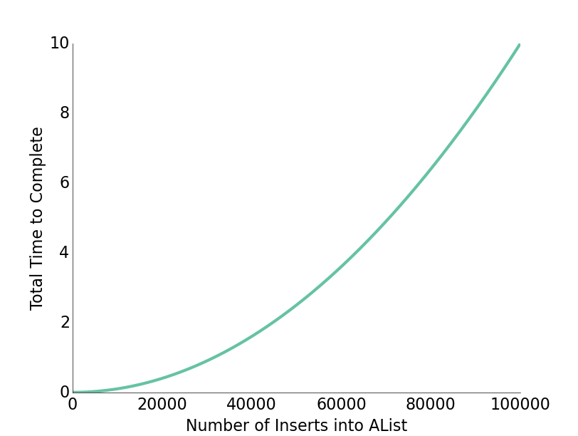
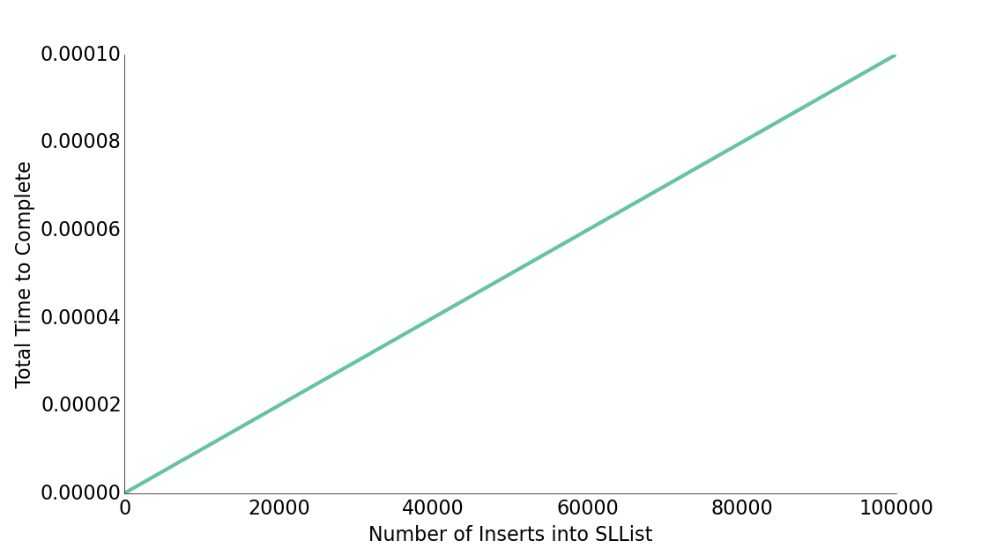
Resizing Slowness
Inserting 100,000 items requires roughly 5,000,000,000 new containers.
Computers operate at the speed of GHz (due billions of things per second).
No huge surprise that 100,000 items took seconds.

Slide 32
Fixing the Resizing Performance Bug
How do we fix this?
private void resize(int capacity) {
int[] a = new int[capacity];
System.arraycopy(items, 0, a, 0, size);
items = a;
}
public void addLast(int x) {
if (size == items.length) {
resize(size + 1);
}
items[size] = x;
size += 1;
}

Slide 33
(Probably) Surprising Fact
Geometric resizing is much faster: Just how much better will have to wait.
public void addLast(int x) {
if (size == items.length) {
resize(size + RFACTOR);
}
items[size] = x;
size += 1;
}
Unusably bad.
public void addLast(int x) {
if (size == items.length) {
resize(size * RFACTOR);
}
items[size] = x;
size += 1;
}
Great performance.
This is how the Python list is implemented.

Slide 34
Performance Problem #2
Suppose we have a very rare situation occur which causes us to:
Insert 1,000,000,000 items.
Then remove 990,000,000 items.
Our data structure will handle this spike of events as well as it could, but afterwards there is a problem.
What is the problem?

Slide 35
Memory Efficiency
An AList should not only be efficient in time, but also efficient in space.
Define the “usage ratio” R = size / items.length;
Typical solution: Half array size when R < 0.25.
More details in a few weeks.
Later we will consider tradeoffs between time and space efficiency for a variety of algorithms and data structures.
addLast()
getLast()
size
items
Usage ratio: 4/100 = 0.04
removeLast()
4
get(int i)
5
3
1
7
0
0
0
0
...
0
0
0
0 1 2 3 4 5 6 7 97 98 99

Slide 36
Generic ALists

Slide 37
Generic ALists (similar to generic SLists)
bleepblrop
public class AList {
private int[] items;
private int size;
public AList() {
items = new int[8];
size = 0;
}
private void resize(int capacity) {
int[] a = new int[capacity];
System.arraycopy(items, 0,
a, 0, size);
items = a;
}
public int get(int i) {
return items[i];
}
...
public class AList<Glorp> {
private Glorp[] items;
private int size;
public AList() {
items = (Glorp []) new Object[8];
size = 0;
}
private void resize(int cap) {
Glorp[] a = (Glorp []) new Object[cap];
System.arraycopy(items, 0,
a, 0, size);
items = a;
}
public Glorp get(int i) {
return items[i];
}
...

Slide 38
Generic ALists (similar to generic SLists)
public class AList<Glorp> {
private Glorp[] items;
private int size;
public AList() {
items = (Glorp []) new Object[8];
size = 0;
}
private void resize(int cap) {
Glorp[] a = (Glorp []) new Object[cap];
System.arraycopy(items, 0,
a, 0, size);
items = a;
}
public Glorp get(int i) {
return items[i];
}
...
When creating an array of references to Glorps:
(Glorp []) new Object[cap];
Causes a compiler warning, which you should ignore.
Why not just new Glorp[cap];
Will cause a “generic array creation” error.
Will discuss in a few weeks.

Slide 39
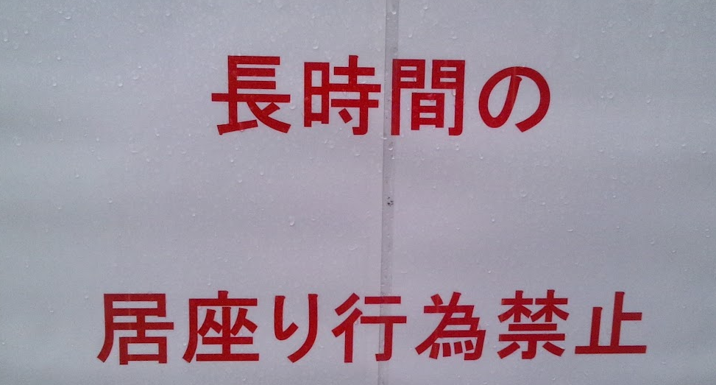


Nulling Out Deleted Items
Unlike integer based ALists, we actually want to null out deleted items.
Java only destroys unwanted objects when the last reference has been lost.
Keeping references to unneeded objects is sometimes called loitering.
Save memory. Don’t loiter.
public Glorp deleteBack() {
Glorp returnItem = getBack();
items[size - 1] = null;
size -= 1;
return returnItem;
}
size
items
3
null
0 1 2 3

Slide 40
Loitering Example
Changing size to 2 yields a correct AList.
But memory is wasted storing a reference to the red sign image.
size
items
2
null
0 1 2 3

Slide 41
Loitering Example
Changing size to 2 yields a correct AList.
But memory is wasted storing a reference to the red sign image.
By nulling out items[2], Java is free to destroy the unneeded image from memory, which could be potentially megabytes in size.
size
items
2
null
null
0 1 2 3

Slide 42
Loitering Example
Changing size to 2 yields a correct AList.
But memory is wasted storing a reference to the red sign image.
By nulling out items[2], Java is free to destroy the unneeded image from memory, which could be potentially megabytes in size.
size
items
2
null
null
0 1 2 3

Slide 43
Obscurantism in Java

Slide 44

One last thought: Obscurantism in Java
We talk of “layers of abstraction” often in computer science.
We also rely on obscurantism. The user of a class does not and should not know how it works.
User’s mental model: {5, 3, 1, 7, 22, -1} → {5, 3, 1, 7, 22}
Actual truth:
addLast()
getLast()
size
items
removeLast()
5
get(int i)
5
3
1
7
22
-1
0
0
...
0
0
0
0 1 2 3 4 5 6 7 97 98 99
Notes:
http://www.learning-mind.com/plato-allegory-of-the-cave/
https://en.wikipedia.org/wiki/Red_pill_and_blue_pill

Slide 45
One last thought: Obscurantism in Java
We talk of “layers of abstraction” often in computer science.
We also rely on obscurantism. The user of a class does not and should not know how it works.
The Java language allows you to enforce this with ideas like private!
A good programmer obscures details from themselves, even within a class.
Example: addFirst and resize should be written totally independently. You should not be thinking about the details of one method while writing the other. Simply trust that the other works.
Breaking programming tasks down into small pieces (especially functions) helps with this greatly!
Through judicious use of testing, we can build confidence in these small pieces, as we’ll see in the next lecture.
Notes:
http://www.learning-mind.com/plato-allegory-of-the-cave/
https://en.wikipedia.org/wiki/Red_pill_and_blue_pill

Slide 46
Citations
Hanging Containers: http://www.portcalls.com/wp-content/uploads/2012/04/hanging_containers1.jpg
Loitering: http://i.istockimg.com/file_thumbview_approve/19711163/6/stock-photo-19711163-red-loitering-prohibited-sign.jpg
http://images.mysecuritysign.com/img/lg/K/No-Loitering-Sign-K-5418.gif http://3.bp.blogspot.com/-NV3y2NQDFy0/UAAXB5gINoI/AAAAAAAALi8/F_bM4-dmsm4/s1600/DVC00575.JPG
Red pill/blue pill: https://en.wikipedia.org/wiki/Red_pill_and_blue_pill

